Slide 1

Covid19 vs Social Places in France
Julien Sauvanet – Coursera capstone – Jan 2021

Slide 2
Context
We’re all impacted by the Covid19, would it be by the health effect of it, or the economical effect of the counter measure government and medical institutes are taking to slow down the virus spreading.
What I’m suggesting in this study is to analyze whether it make sense to close almost everything everywhere as it has been done in France, or if we can try to have a deeper understanding on what are the most visited areas/places/shops so we can mitigate the close-down action to certain shops and thus mitigate the economical impact it causes.

Slide 3
Question
Question I want to address is : Can we see relationship between large cities' social places (such as bar, restaurant, cinema, theatre, ... ) and positive Covid19 cases in France ?
My assumption is that the more we would have Social places the highest would be the number of Covid positive cases..
How to figure out ?
I'm going to get the list of biggest cities on France, get the numbers about the Covid19 cases in France, get the top most visited social places information from FourSquare for these cities. Aggregating these different data sets, I will leverage the clustering techniques to highlight similarities and hopefully get some insight of my original question.

Slide 4
Business Problem
The economical impact of closing everything down is becoming huge everywhere. There are many different shops being closed even though the medical protective measure were in place. Economical impact could be even bigger than the medical impact. Looking at the problem by mixing the most visited places and types of places vs the number of cases can shade some lights on what are the places we could open again.
By looking at the most visited places, sorted by categories, for the Top80 largest cities in France, we may see interesting facts that could help in refining the lock down measure for some shop categories, in these cities being observed (and may be extrapolate for other cities from the same area or expand the study to a wider scope of cities)

Slide 5
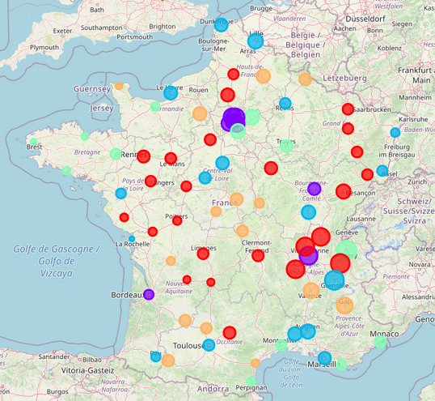
Observations
Cluster description - visual representation legend
Cluster 0 -- with 2080744 peoples, "Positive over tested case mean" in that cluster: 0.04497161293123582
Red
'In that cluster it is clear that Train stations/Transportation as well as restaurant are the most visited places and transportation are usually closed areas.. Cluster 0 is composed of largest cities where there is a lot of public transportation, eg bus or train. It would make sens to be very caution on how we handle public transport when thinking of Covid19 spread.. e.g before closing shops or libraries'
Cluster 1 -- with 4044811 peoples, "Positive over tested case" mean in that cluster: 0.05121959287932119
Purple
'In that cluster we observe that the common most visited places are Hotel and Plaza (outside famous places).. This may suggest that hotel could be an significant vector of Covid19 propagation in these cities. thisi is also the cluster showing the highest Covid 19 Positive ratio '
Cluster 2 -- with 3479153 peoples, "Positive over tested case" mean in that cluster: 0.045504310292086785
Blue
'In that cluster we observe that clearly the restaurant are the top visited place. It suggest that in these cities is may be relevant to work on Restaurant area to reduce the virus spread. Other places/shops not being from the top10 observed could remain open'
Cluster 3 -- with 2188467 peoples, "Positive over tested case" mean in that cluster: 0.0447401245843587
Light Green
'In that cluster we observe that REstaurant, Hotel and Café are the most visited areas. Recommendations for these cities could be to adapted and focused on these areas'
Cluster 4 -- with 741186 peoples, "Positive over tested case" mean in that cluster: 0.0429404255499712
Orange
'From that cluster we observe that Hotel and Supermarkets are the most visited areas. Although Hotel lock down could be handled, Supermarket is hard to handle as it is part of the primary shops to remains open. Extra sanity care should be done in the supermarket in these cities '

Slide 6
DISCUSSION
The clustering groups the largest French cities into 5 clusters (I set it ot 5), based on the most visited places, here grouped by categories.
There is no region-specific grouping in the observation we are making . Cluster members are from all over the French Territory ( including those out of metropole , in the Pacific ocean and Atlantic where we have French's Islands
There is one small part of France which is not having any cities being represented, this is because there is no large cities in this area of the country. ( Massif Central , Center Down of France)
Initial observation shows that there is not big difference in the "positive to tested for Covid" ratio, which is from 4.2 to 5.1%
Per Cluster observation shows that there are cities where there is a bigger "positive to tested for Covid" ratio, above the max of the average ( so > 5.1% ) .. These cities are spreader across different regions, belonging to different clusters. However, 4 out of the 16 Cities beyond 5.1% are belonging to the same region : Wider Paris Cities, and they have in common some most visited places : Hotel, Supermarket, Restaurant and Transportation areas (Train or Airport)
Another interesting observation is to list the cities having the biggest "Positive to Tested" ratio. This is a focused view to understand what are the social places which correspond to the highest Covi19 Positive to Tested ratio
-Shopping
Hotel
Train Station (Public Transportation)

Slide 7
CONCLUSION
Purpose of this project was to observe a possible group or relationship between the places where people usually visit and the Covid19 positive cases. The aim was to try to understand whether the lockdown of certain shops/places was critical/useful in stopping the virus propagation. .
I have to mention that the study accuracy could have been more specific but the Covid datas available publicly are not given at deeper details than Department, so I had to assume that largest cities in these departement are the most representative..
Cluster0, which could be named Cluster-Transport shows clearly that most of the people concentration is on public transportation, which makes sense in those big cities. It is clear that these places are areas where there is a big risk of virus propagation.
Cluster1, which could be named Cluster-Traveller , seems to be the most representative ( most people -- 4M+, largest Positive/Tested ratio -- >5% ) is clearly pointing Paris and nearby area, Lyon and Bordeaux, which are amongst the top10 biggest cities in France , shows that most visited places are Hotel and famous toursitic places.. which brings some questions around the travelling factor of the Covid19 spread.. This is likely that people visiting these palces are coming from elsewhere, even somewhere out of France.
Cluster2 could be named Cluster-Restaurant .. clearly shows that restaurant are the most visited places..
Cluster3 could be named Cluster-Leisure , where we observe that relaxing places such as beach and hotel are the most visited places. Looking at the map we understand we talk about summar vacation places ( seas, oceans , mountains ). They are likely to be outside places ( not indoor places ).
Cluster4 could be named Cluster-SuperMarker , we observe that most visited places are supermarkets
Based on these observations, across the clusters, We understand why Restaurant have been closed, why travel have been drastically reduced..
However, I’m not seeing much places like theatre, cinemas, museum, libraries, .. although these shops/places where also included in the lock down . This study brings some facts to an interesting question : " Do we have to close as many shops as we did ? Closing is it worth the economical impact it represents ?

